Slide 1
GENDER IDENTIFICATION USING SPEECH SIGNAL Guided by: DR. sanghamitra nath
Submitted by:
Hirak Jyoti Nath (CSM17033)
KM Prauti (CSM17033)
MCA 5th semester

Slide 2
ABStract
Gender is a specific characteristic of individuals. In this work we attempt to identify human gender using speech signal characteristics such as Mel spectrograms and classifiers such as Convolution Neural Networks.

Slide 3
INTRODUCTION
Gender identification, language identification, emotion recognition etc. of speech through trained classifiers using speech signal properties has a increased attention in recent years. Accurate classification of above said attributes can be used for other applications based on speech signals such as human-computer interaction, surveillance, speech recognition, speaker recognition, speech coding, language dependent searching, biometrics, gender specific advertising etc.
In our work we have tried to identify the gender of a speaker using speech signal properties.

Slide 4
LITERATURE REVIEW
At the beginning of this work , we have gone through various research papers based on gender identification using speech signal. We have found several classifiers such as GMM, i-vector, CNN etc which have been used to model the dataset. Compared to GMM and i-vector models, we have seen that CNN have been able to show superior performance in this regard.
That is why we have selected CNN model for classification of speech sample. But CNN needs huge amount of data to provide accurate results.
 |  | Female
Male |  | 15
Female | 1 | 119

Slide 5
DATA SEt
We use the LibriSpeech corpus of audiobook data to train and evaluate models. We use the train-clean-100 for training. This data contains audio from controlled environments, no external noise just recording artifacts such as microphone buzz.
The LibriSpeech corpus is available free of charge. In this project we have used 88.78 minutes (approx. 1.47hrs) of “clean” speech.
Each voice sample format is a .FLAC file. The pre-processed FLAC files have been saved into a CSV file. The CSV file is contained 403 rows and 4 columns.

Slide 6
FEATURE EXTRACTION
With the help of package Librosa we load the audio file as a floating point time series constant, with a default sampling rate of 22050Hz(22.05KHz).
We compute the melspectogram of the audio signal to generate the log-scale melfrequency.
The mel frequency scale is defined as:
mel = 1000/ log(2)*(1+ F /1000)

Slide 7
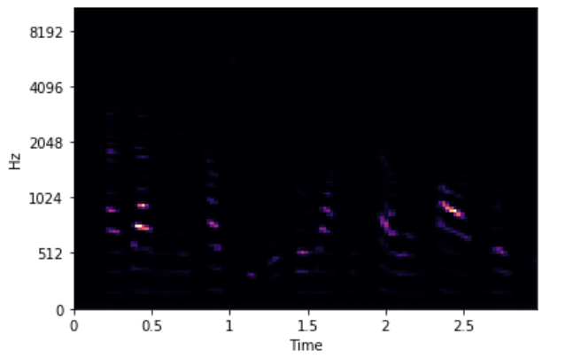
FEATURE EXTRACTION
Fig: Melspectrogram of an audio speech sample(.FLAC file)

Slide 8
Deep Convolutional Neural Network
The deep convolutional neural network (CNN) architecture proposed in this study is comprised of 3 convolutional layers interleaved with 2 pooling operations, followed by 2 fully connected (dense) layers.
The input to the network consists of timefrequency patches (TF-patches) taken from the log-scaled melspectrogram representation of the audio signal.

Slide 9
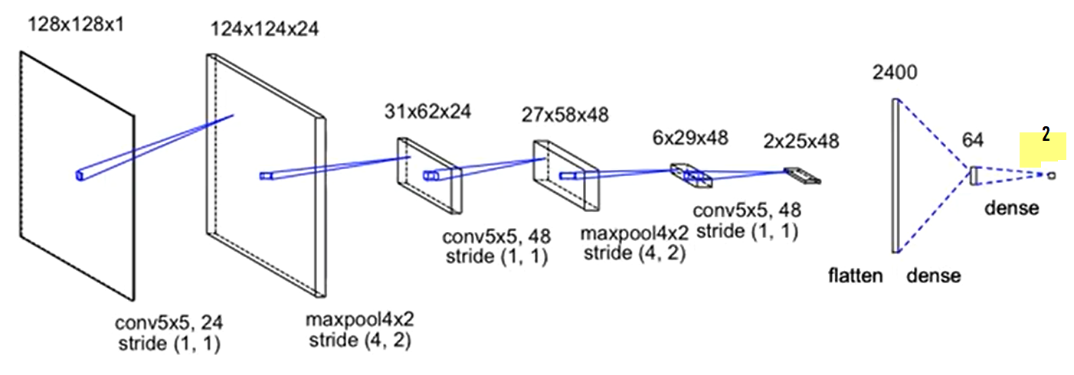
Deep Convolutional Neural Network
Fig: Convolutional Neural Network Architecture

Slide 10
CONCLUSION
Our work shows that we can use acoustic properties of the voices and speech to detect gender of the speaker. A deep CNN model has been realized to segment speech streams into male and female excerpts. This positive outcome allows us to perform large-scale gender statistic descriptions, offering concrete perspectives for digital humanities.

Slide 11
FUTURE SCOPE
In future, we can further enhance this project into a Speaker diarization. Speaker diarization is the process of partitioning an audio stream with multiple people into homogeneous segments associated with each individual.
By solving the problem of “who spoke when”, speaker diarization has applications in many important scenarios, such as understanding medical conversations, video captioning and more.

Slide 12
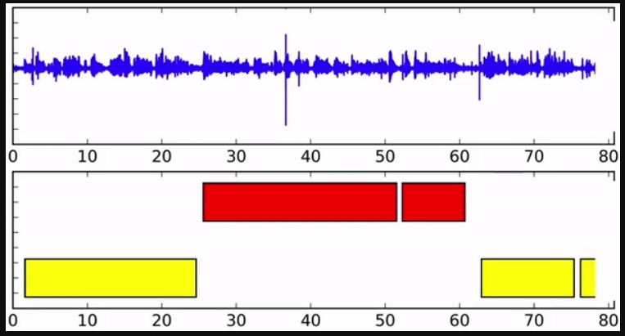
FUTURE SCOPE
Fig: Online speaker diarization on streaming audio input. Different colors in the bottom axis indicate different speakers.

Slide 13
THANK YOU

